Slide 1
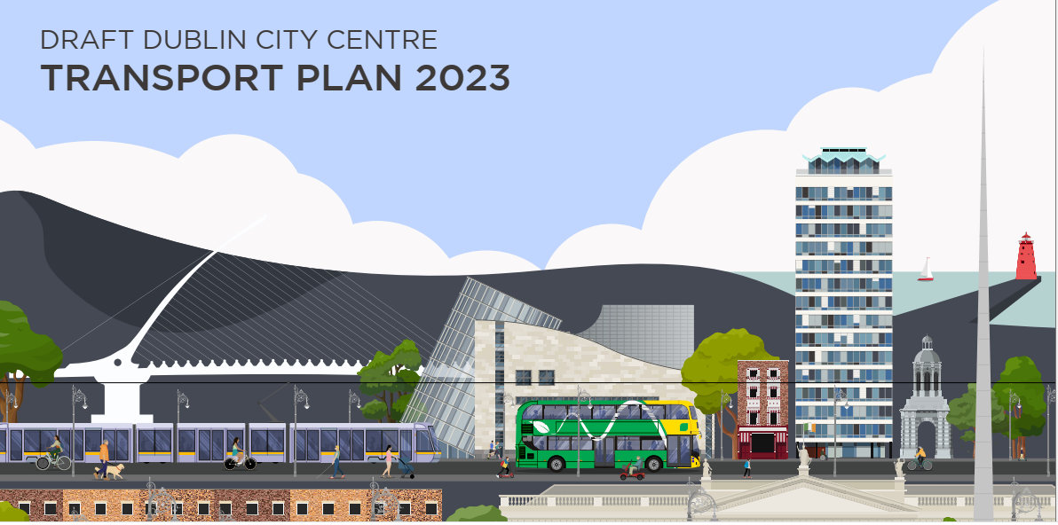
Transportation SPC Briefing September 2023 Brendan O’Brien Hugh Creegan NTA

Slide 2
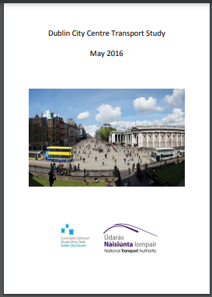
City Centre Transport Study 2016
2015: Dublin City Council and the NTA published a draft City Centre Study which set out a series of proposals and objectives for City Centre Transport until 2023
2016: A final report was published following an extensive consultation process

Slide 3
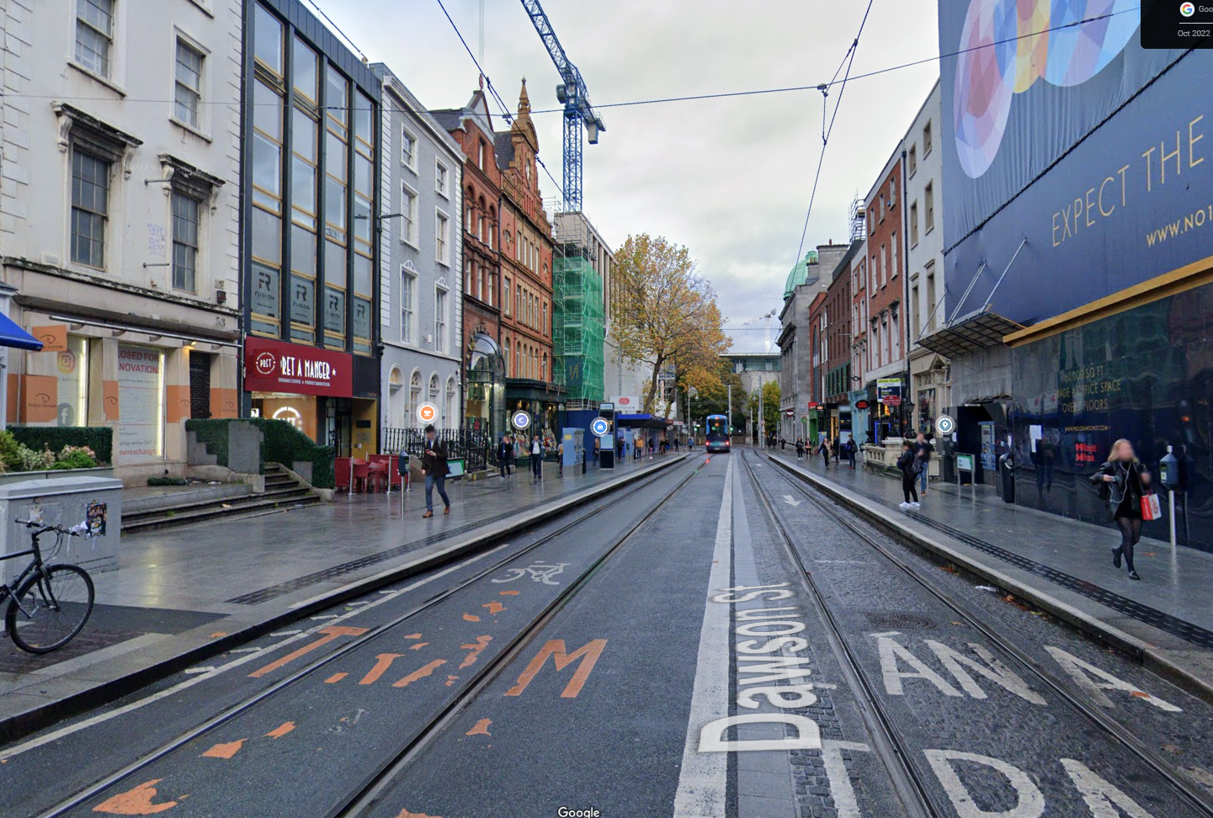
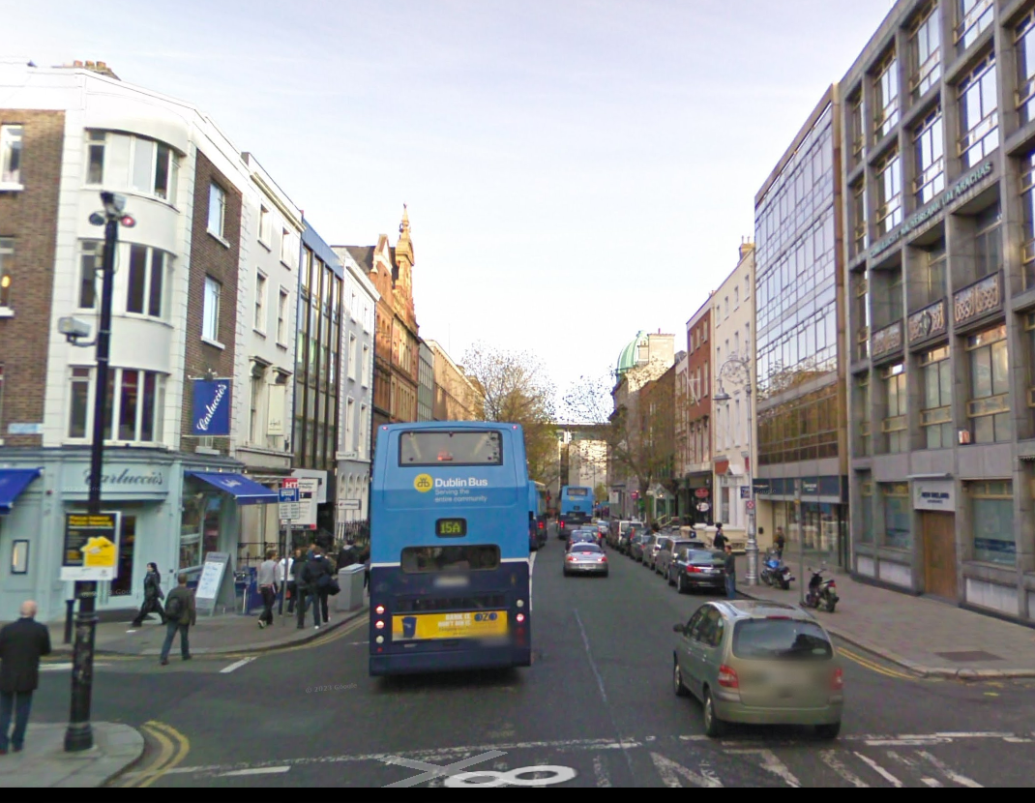
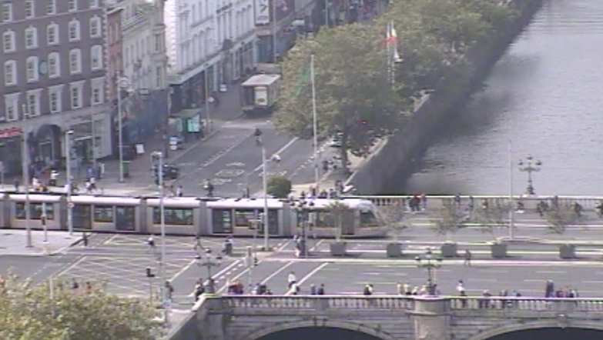
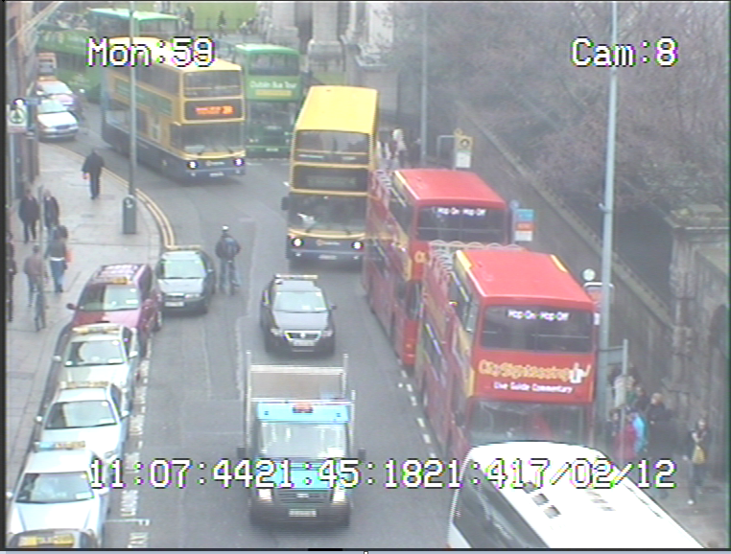
City Centre Transport changes 2016 – 2023
Successful introduction of Luas Cross City
Dawson Street traffic calmed
Public Transport only section from Duke Street to Westmoreland Street

Slide 4
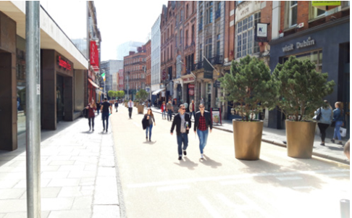
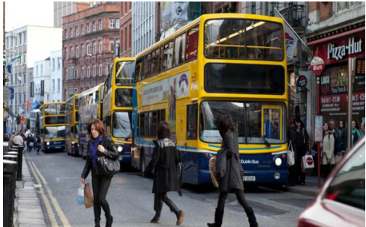
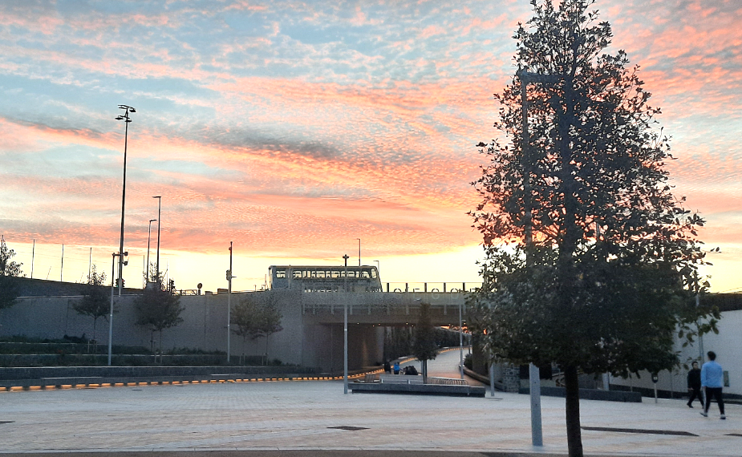
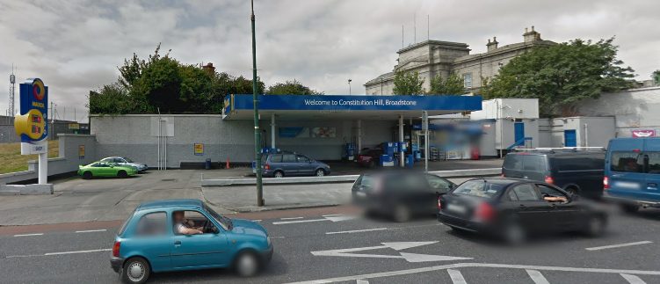
City Centre Transport changes 2016 – 2023
Suffolk Street Traffic Free
Broadstone Plaza

Slide 5
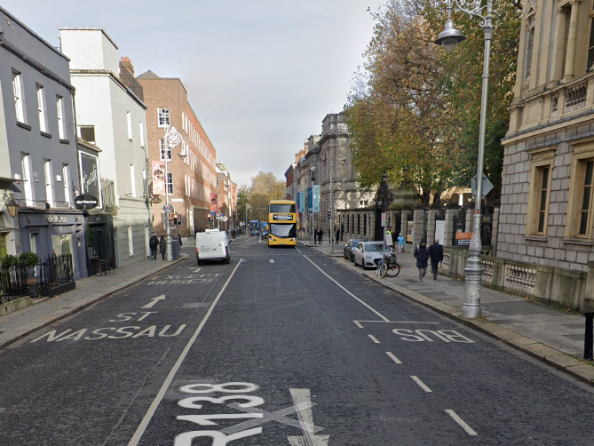
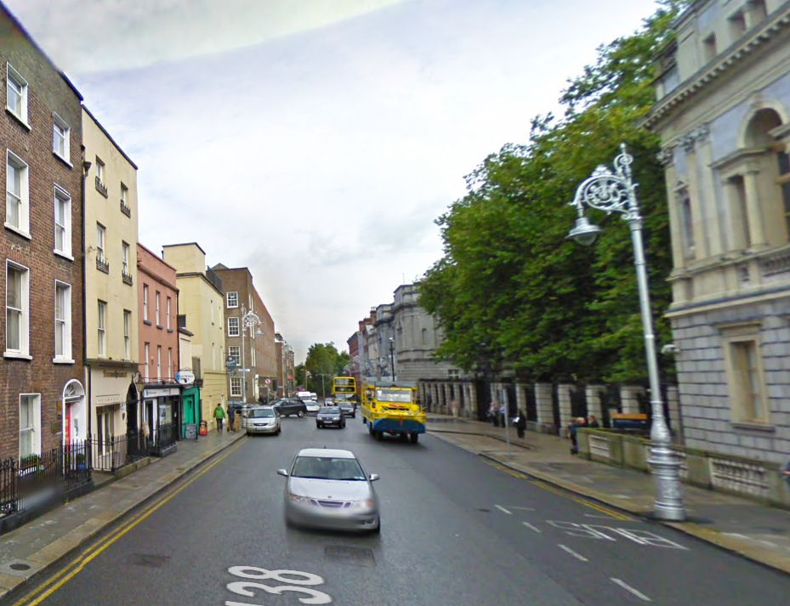
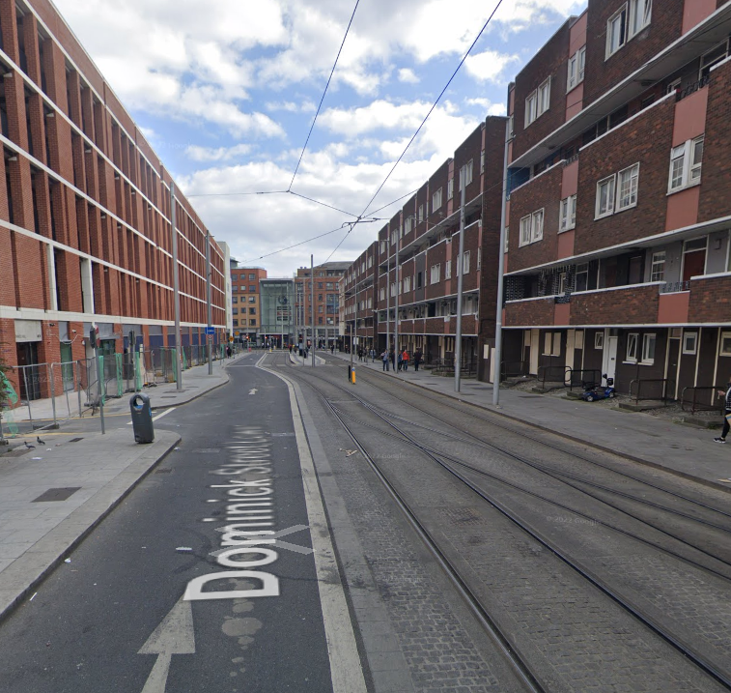
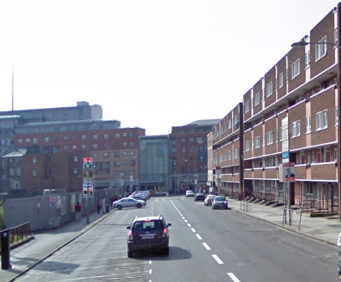
City Centre Transport changes 2016 – 2023
Numerous traffic Changes required across the city
Stephen’s Green North East/ Merrion St
Kildare Street
Grafton Street Lower two way PT
Kildare Street 2 way with PT lane
Double Bus Lane Introduced North Quays and Bus Signals
Bus Lane South Quays
Dominick Street one way

Slide 6
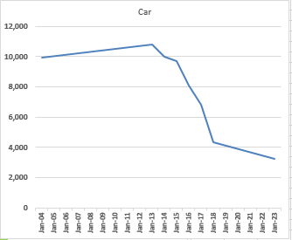
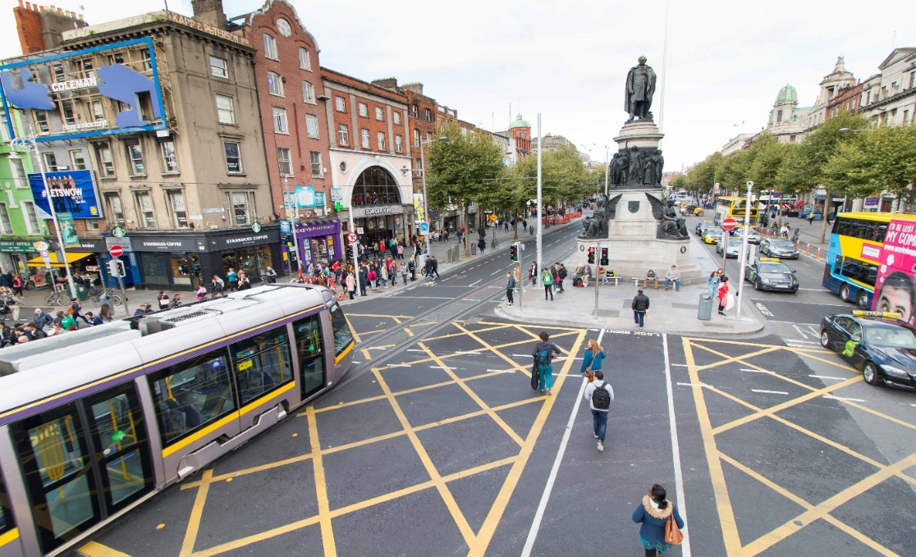
City Centre Transport changes 2016 – 2023
Bachelors Walk 2004 – 2023 Car numbers: 68% reduction

Slide 7
City Centre Transport Plan 2023
The Dublin City Development plan 2022- 2028 has the following Objective

Slide 8
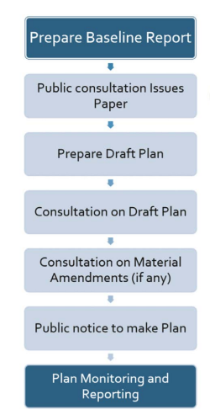
What is the Dublin City Development Plan 2022-2028
Steps in the preparation of the Development Plan
Elected Members as Decision-Makers
The adoption, or ‘making’ of the Development Plan
is the responsibility of the elected members
(City Councillors) and is a reserved function under
Section 12 of the Planning and Development Act.
The City Development Plan was adopted in November 2022

Slide 9
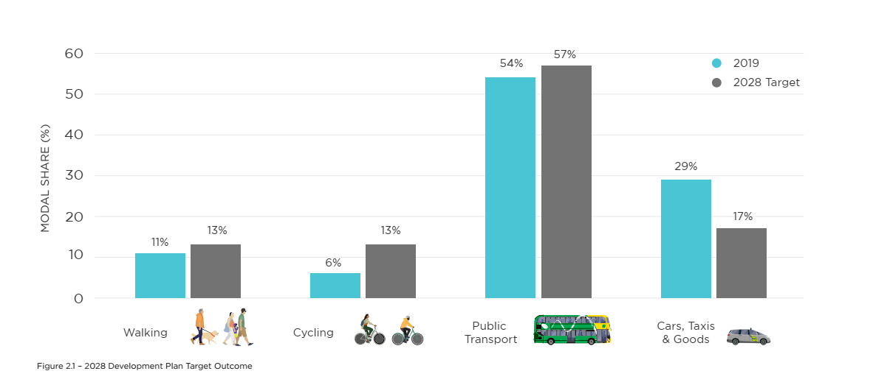
Dublin City Development Plan 2022-2028

Slide 10
Dublin City Development Plan 2022-2028
These Development Plan targets translate into the following objectives:
Reduce cars numbers in the city by 21,500 (Based on 2019 numbers)
Increase PT, walking and cycling numbers by 47,000
These targets will require significant change in the city centre, focusing on prioritizing Public Transport Walking and cycling
Currently roughly 6 of every 10 cars entering the core City Centre across the day are passing through to external destinations (7am – 7pm).

Slide 11
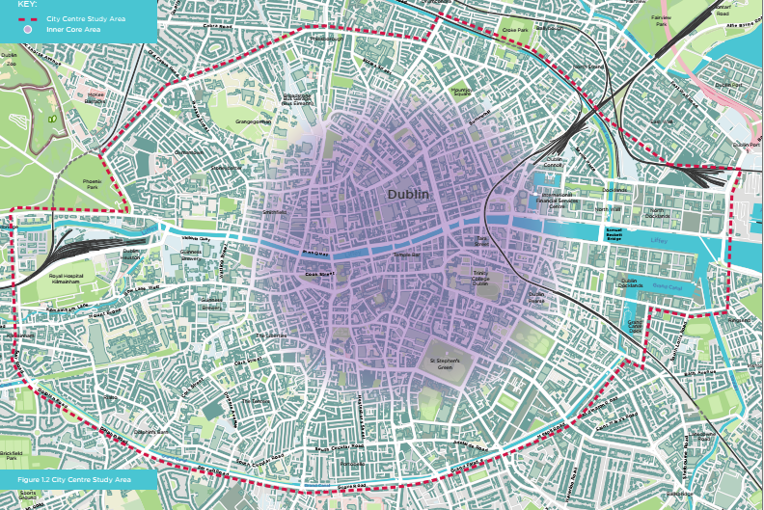
Study Area

Slide 12
City Centre Plan 2023
The purpose of this plan is to identify and prioritise changes to the current transport arrangements which are necessary to fulfil the vision of the city set out in the City Development Plan and adopted by the Elected Members.
The Plan also facilitates the implementation of the NTA’s Transport Strategy for the Greater Dublin Area 2022–2042 by providing a framework for accommodating significantly higher numbers of people travelling into the City Centre by rail, bus, cycling and walking.

Slide 13
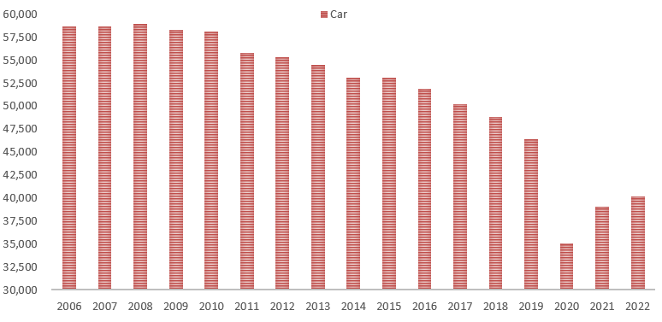
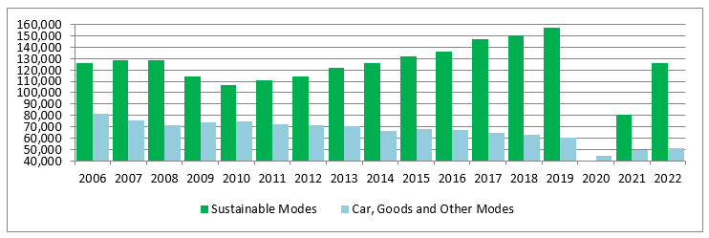
Dublin City Canal Cordon Count 2006-2022
Number of Cars Crossing Cordon in AM Peak Period, 2006-2022
Number of people crossing the canal cordon 07:00- 10:00 2006 – 2022

Slide 14
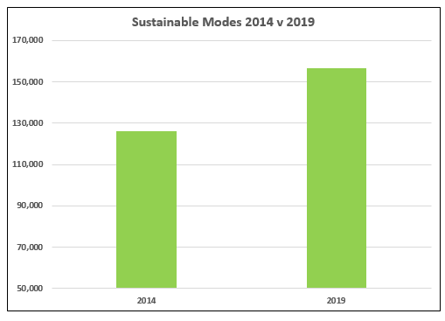
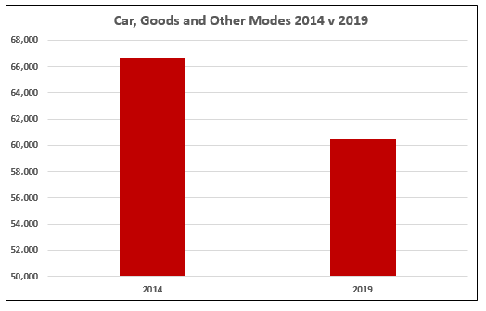
Dublin City Canal Cordon Count 2006-2022

Slide 15
City Centre Public Transport Projects
Bus Connects Network redesign in progress with new routings and requirements for new bus stopping locations.
Bus Connects Corridors (with ABP) --- anticipated start 2024/5
DART + project (with ABP)
Metro Link (with ABP )
Active Travel Network --- on going

Slide 16
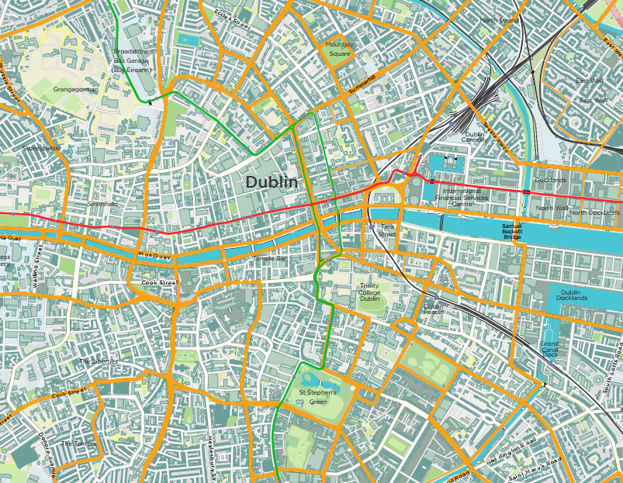
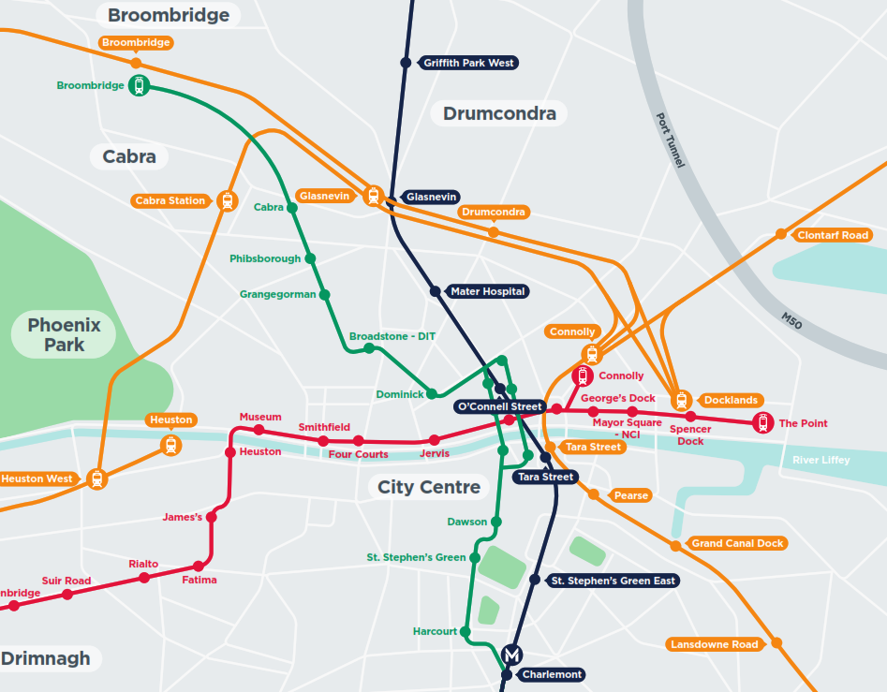
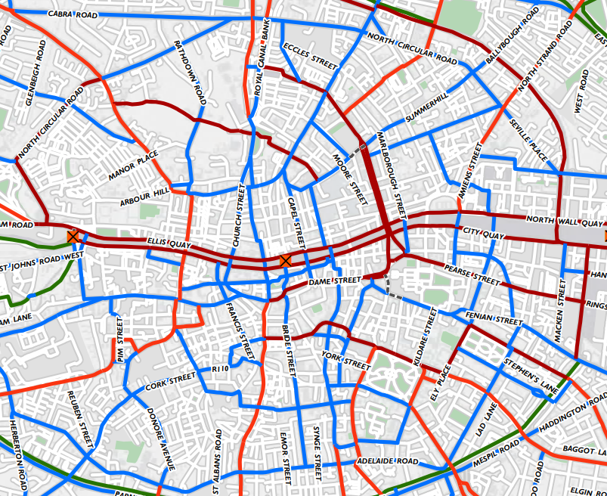
City Centre Networks
The coming years will see the continued delivery of the new BusConnects network of bus services, coupled with the roll-out of Cycle Connects and various pedestrian focussed projects. In addition, there is also a need to accommodate, and provide for, both rail transport and connectivity to stations.
BusConnects Bus Network
Rail Network (Heavy/Light/Metro)
Cycle Connects Network

Slide 17
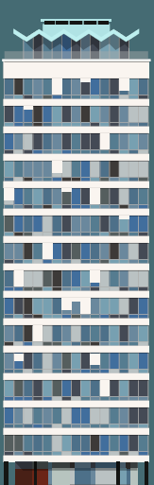
Aims of the revised traffic arrangements
The major changes that are underway both in the public transport network and the cycling and walking network means that the general traffic network cannot be left as is but must be adjusted to:
Allow the Public Transport network to grow and to provide for stable journey times across and through the city centre.
Provide the opportunities for multi modal interchange by providing additional space for stops and waiting areas.
Allow the construction of public transport projects (Metro Link).
Make space to allow the growth of the cycling network.
Make the walking network more connected and pleasant through the creation of new public realm areas, reduction in general traffic lanes and facilitate better crossing points.
Ensure accessibility to and continued ability of businesses to operate.

Slide 18
Proposed changes in the general traffic network
60% of traffic in the city centre is through traffic leading to :-
Delays for public transport on the network in the city centre
Congestion and difficulties for servicing of the city
Constricting space for cyclists and making implementation of the cycle network far more difficult
Implementation of a number of changes in 2024 and 2025 will have the aim of reducing this through traffic creating a low traffic environment in the City Centre

Slide 19
Proposed Traffic Management changes
The implementation of the Dublin City Transport Plan will begin with a series of traffic management changes.
Bachelor’s Walk Bus Gate: Bus gate on Bachelor’s Walk close to O’Connell Bridge for public transport, taxis, cyclists and pedestrians only.
Aston Quay Bus Gate: Bus gate on Aston Quay close to O’Connell Bridge, for east-west movement to public transport, taxis, cyclists and pedestrians.
Westland Row – Left Turn PT only: Bus only left turn Westland Row to Pearse Street.
Two Way Pearse Street Westland Row to Sandwith Street: New right turn at Westland Row to two way Pearse Street – allows high sided vehicles a safe route under the railway bridge.
Pearse Street / Tara Street: The implementation of the changes at Westland Row / Pearse Street will reduce traffic on Pearse Street and Tara Street allowing reduction in traffic lanes providing scope for increased pedestrian space and safe cycling provision.

Slide 20
Proposed Traffic Management changes
Beresford Place / Custom House Quay: The implementation of the traffic management changes proposed on the Quays and Pearse Street will allow for significant changes around this area.
College Green / Dame Street: Implementation of proposals to make College Green and Dame Street traffic free (except for access and deliveries).
Parliament Street: Parliament Street to be made traffic free, once Bus Network changes are complete, Cycle link to Capel Street.
Other Local Interventions: The above earlier phases of changes open up potential other more localised traffic changes, giving rise to extra space for sustainable modes and public realm enhancements. These include locations such as Lincoln Place (subject to bus turning movement confirmation), Christchurch Place and others.

Slide 21
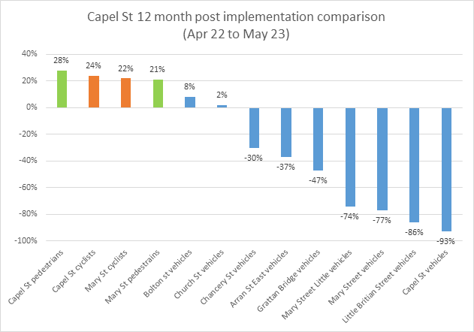
Capel Street Example
Implemented in May 2022, multiple changes around the area made initially, as problems developed.
Changes once bedded down, allowed Mary Street to be added and will allow the proposal in Parliament Street to be implemented.
Work now underway on streetscape enhancements for walking and cycling.

Slide 22
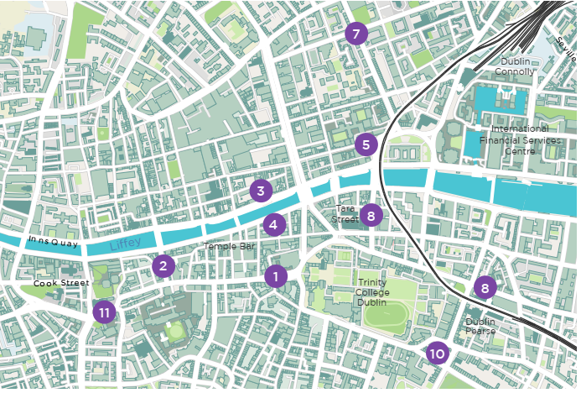
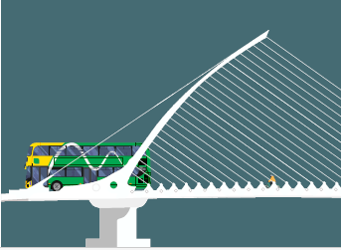
Developing the Solution - Opportunities for Dublin City
As the Traffic volumes decrease, significant opportunities become available to reimagine parts of the city.
The following represent a selection of conceptual projects which become possible as traffic volumes reduce.
Several of these are proposed to be quickly implemented on an interim basis pending the more long term permanent implementation.

Slide 23
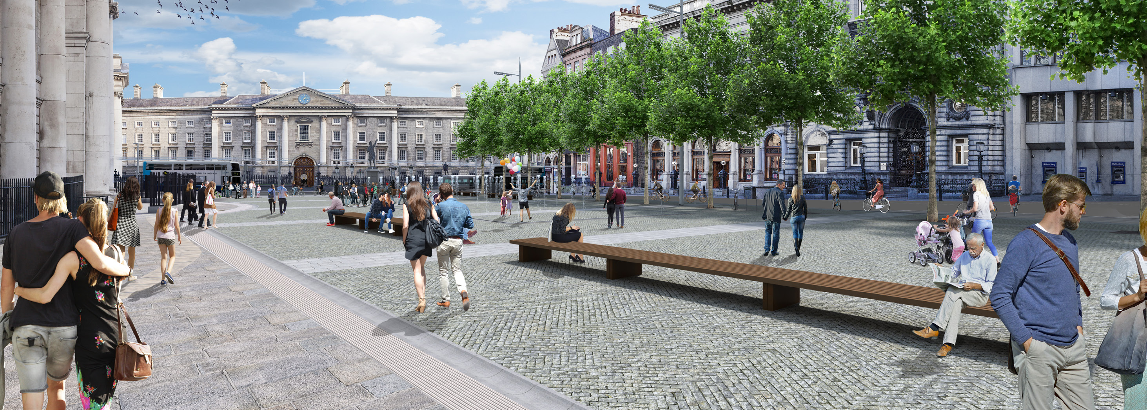
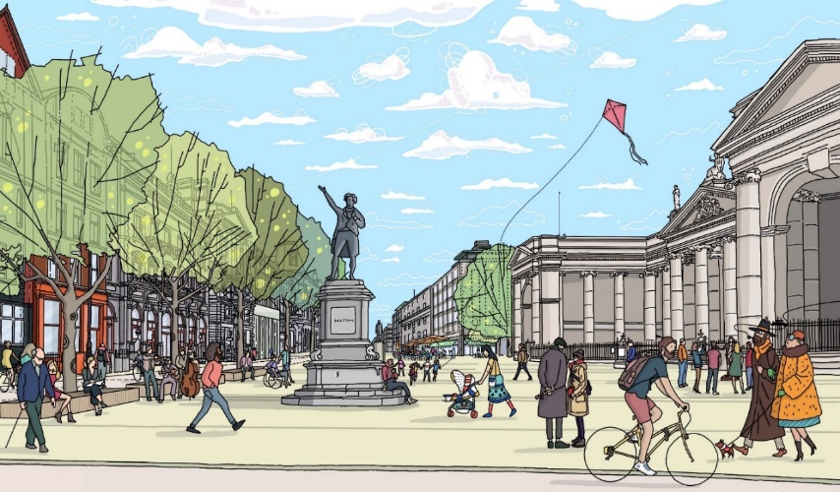
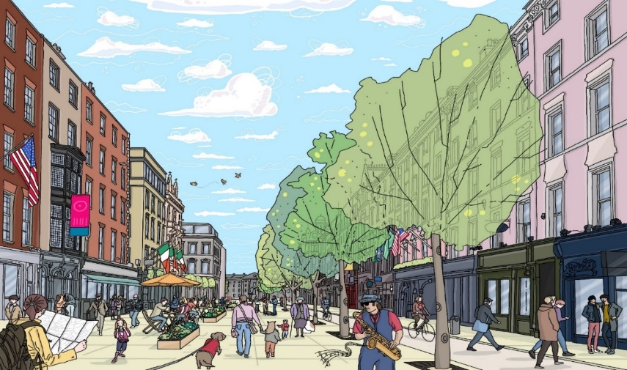
Opportunities for Dublin City – College Green /Dame Street
Traffic Free in 2024/5 once Network Redesign has moved buses from the area.

Slide 24
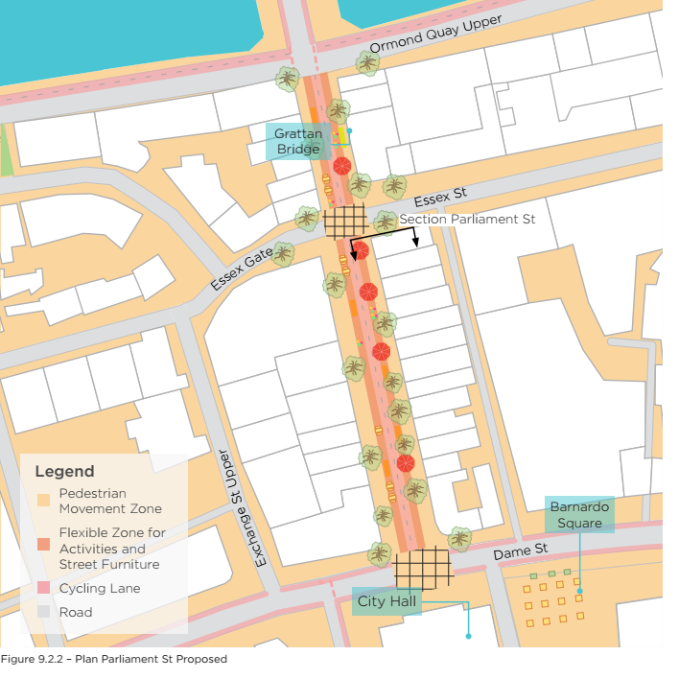
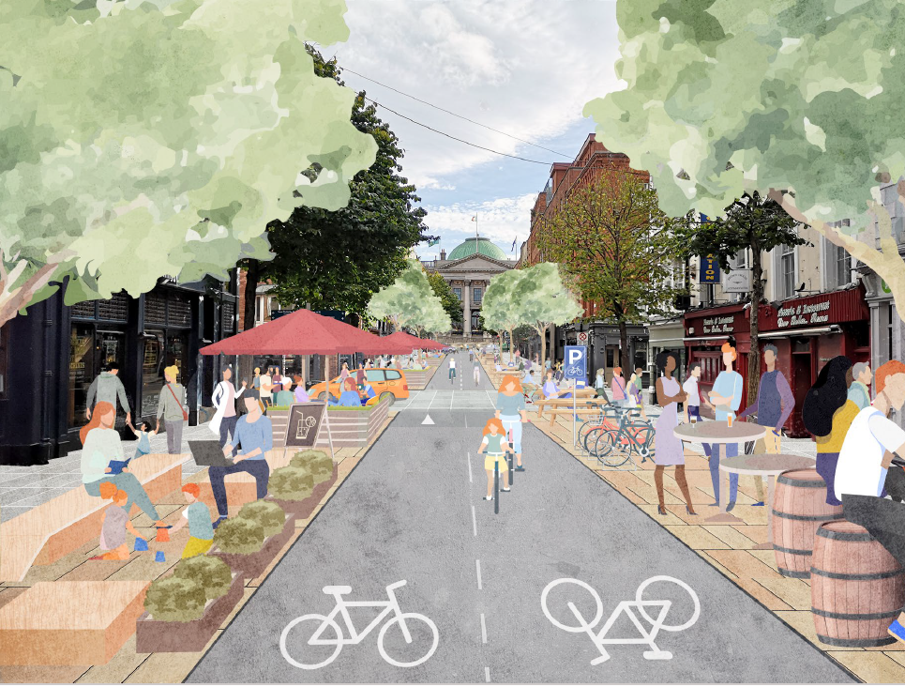
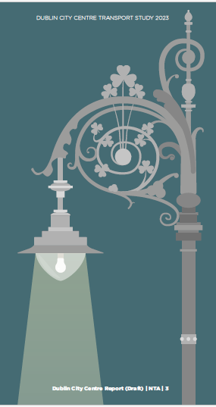
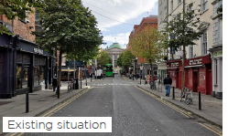
Opportunities for Dublin City – Parliament Street

Slide 25
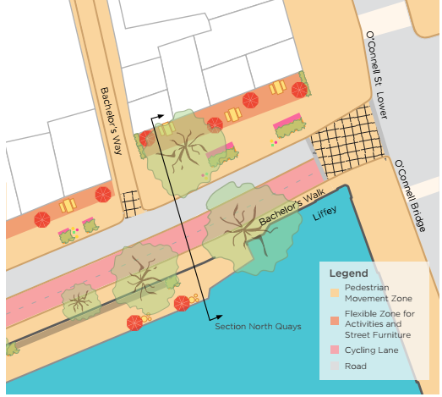
Opportunities for Dublin City – The Quays
The reduction in vehicular traffic will facilitate a significant reallocation of space, notably for pedestrian and cycle movement.
The extra space will also allow reconsideration of bus routing and stopping arrangements which are currently constrained by traffic management arrangements.

Slide 26
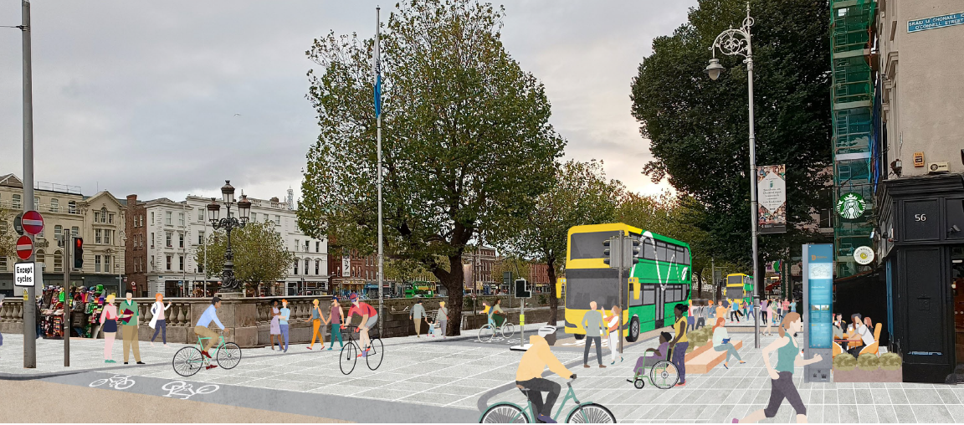
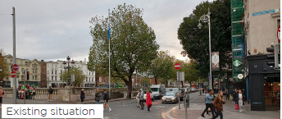
Opportunities for Dublin City – The Quays

Slide 27
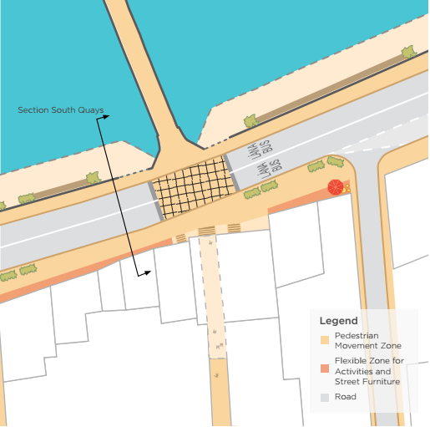
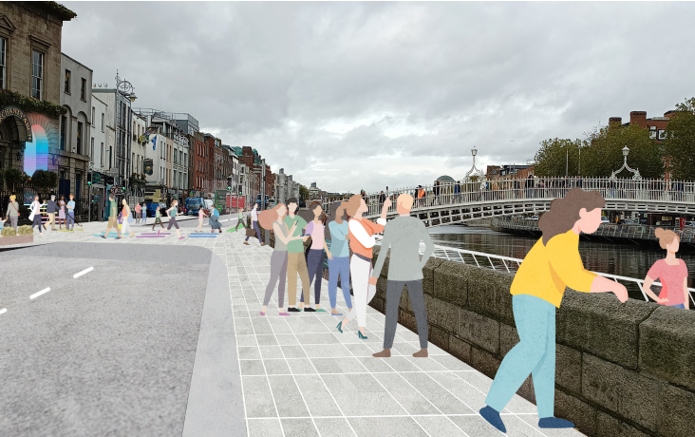
Opportunities for Dublin City – The Quays

Slide 28
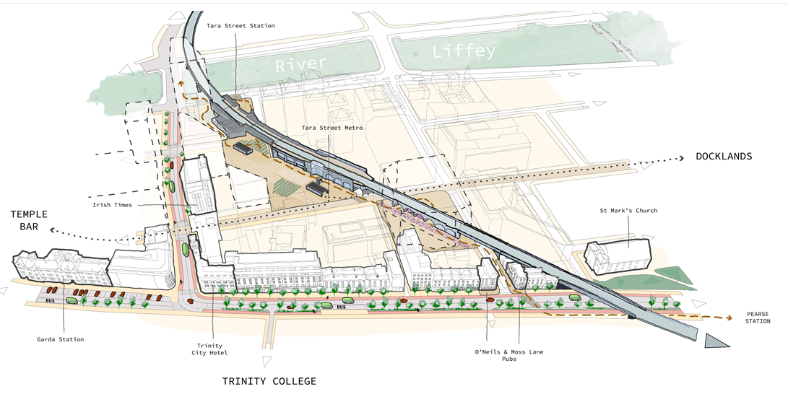
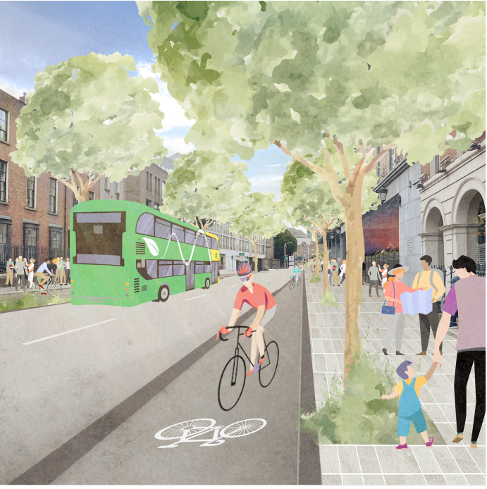
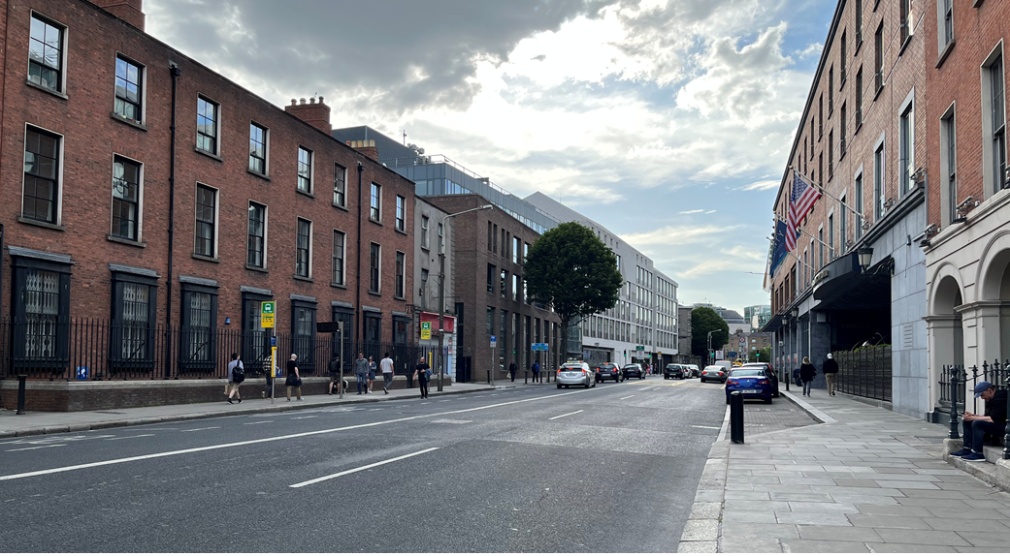
Opportunities for Dublin City – Pearse Street

Slide 29
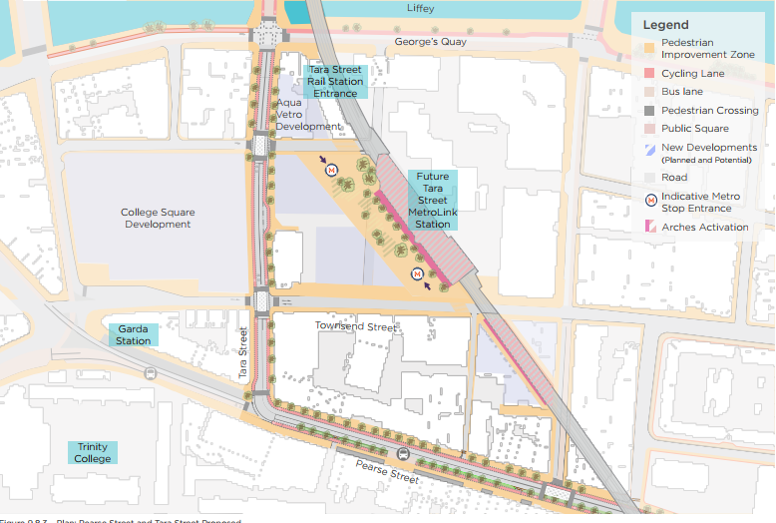
Opportunities for Dublin City – Tara Street

Slide 30
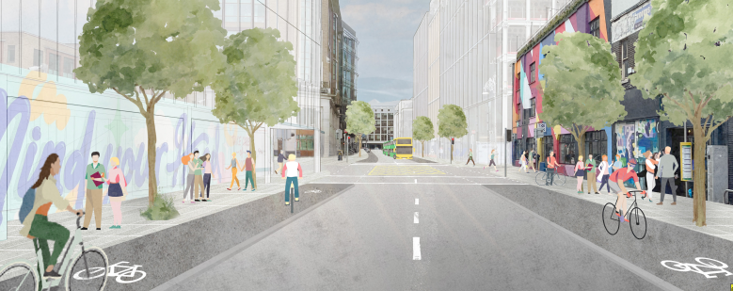
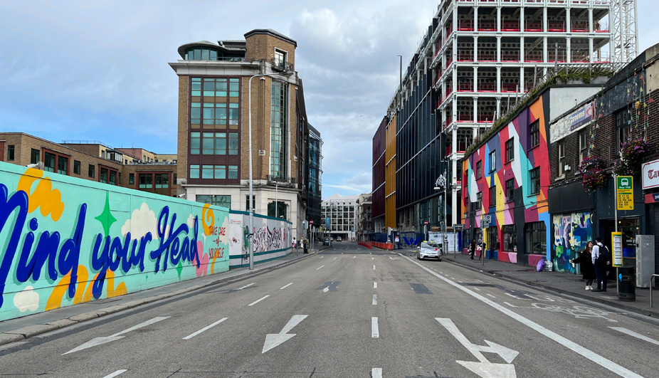
Opportunities for Dublin City – Tara Street

Slide 31
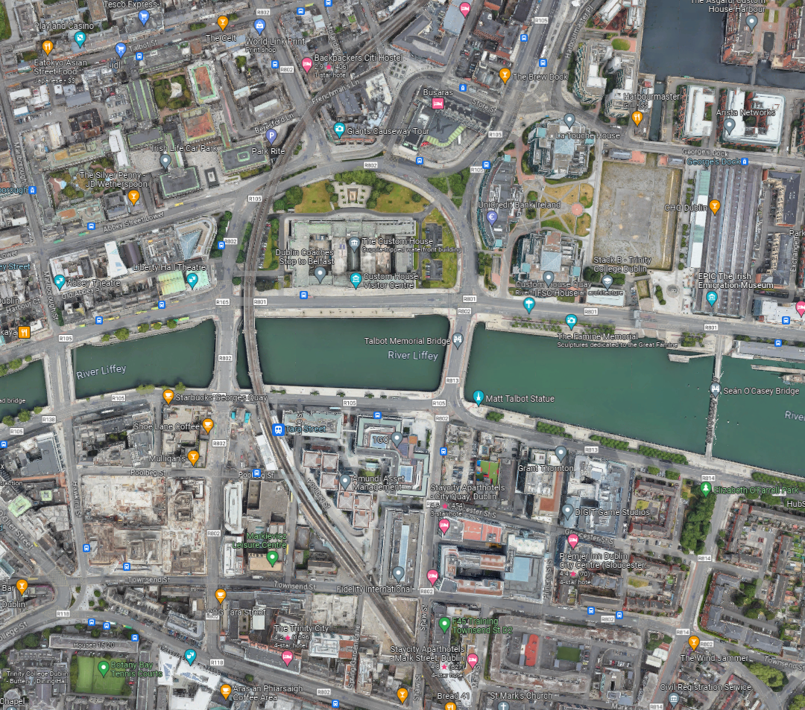
Opportunities for Dublin City – Future Options for Customs Quay or Beresford Place

Slide 32
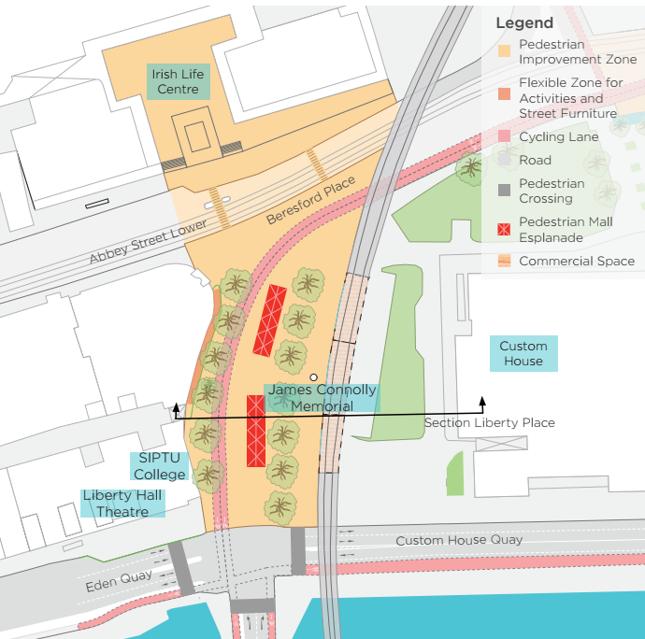
Opportunities for Dublin City – Future Options for Customs Quay or Beresford Place
Option 1 Intervention at Beresford Place Eden Quay

Slide 33
Opportunities for Dublin City – Future Options for Customs Quay or Beresford Place
Option 1 Intervention at Beresford Place Eden Quay

Slide 34
Opportunities for Dublin City – Future Options for Customs Quay or Beresford Place
Option 2 Intervention at Custom House Quay

Slide 35
Opportunities for Dublin City – Future Options for Customs Quay or Beresford Place
Option 2 Intervention at Custom House Quay

Slide 36
Opportunities for Dublin City – Gardiner Street

Slide 37
Opportunities for Dublin City – Gardiner Street

Slide 38
Opportunities for Dublin City – Lincoln Place

Slide 39
Opportunities for Dublin City – Lincoln Place

Slide 40
Opportunities for Dublin City – Christchurch

Slide 41
Key outcomes of the Dublin City Centre Transport Plan
Reduction of up to 60 % of car traffic in city core meeting DCC policy to make the City Centre a low Traffic environment.
More reliable and frequent Public Transport.
Reduced emissions due to reduction of 34% in Kms travelled by private car in city centre.
Reduction in population exposed to traffic noise.
Improved cross-city pedestrian connectivity with 30% less time waiting at junctions on the walk from Stephen’s Green to the Spire.
17% reduction in pedestrian wait time at O’Connell Bridge.
Opportunity for cycling projects to cross and connect through the city centre.

Slide 42
Next Steps for the Dublin City Centre Transport Plan
Public consultation commences today until the 1st of December.
It will be accompanied by a full SEA / AA.
The public consultation report and final version of the City Centre Plan will be presented to the SPC in February 2024.

