Slide 1
Strand Road Trial Modelling analysis and Traffic data
05/10/2020

Slide 2
Traffic Data
Within the area covered by the trial DCC have the following data:-
Cordon count data and classified counts at a number of locations.
Traffic data from the DCC SCATS Traffic Control system
Count of barrier activations at Merrion gates Level crossing
CCTV at a number of locations linked to DCC Traffic Control Centre for real time monitoring of traffic conditions.
Noise monitor on Strand Road
EPA environmental monitor Ringsend Road

Slide 3
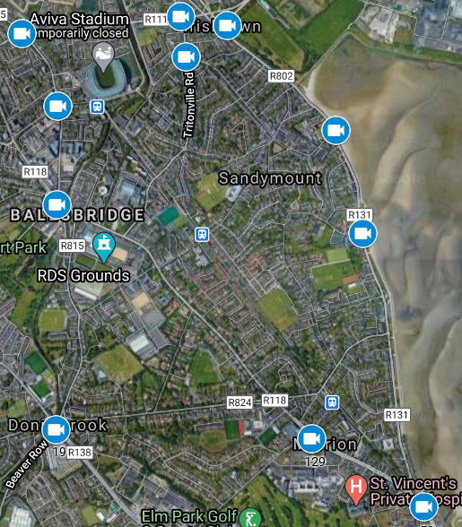
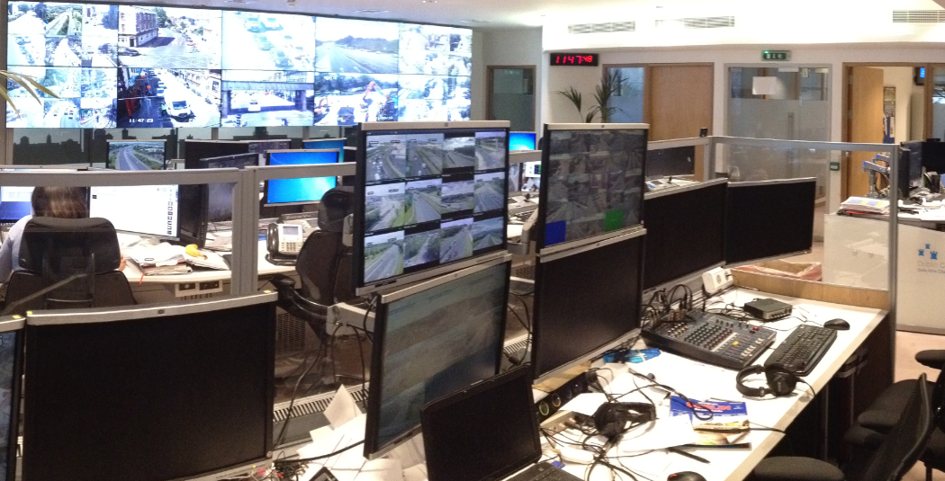
Existing and new CCTV locations
Linked to the DCC 24/7 control centre

Slide 4
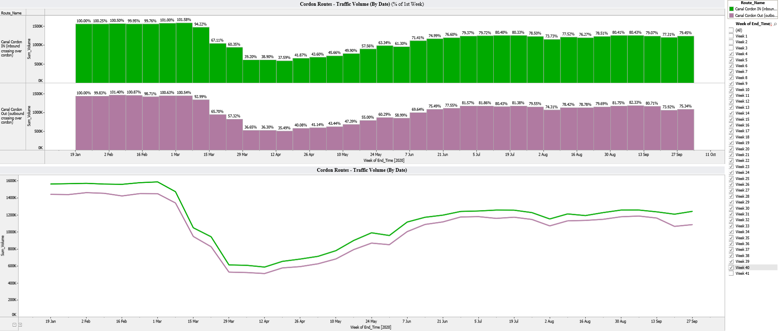
Traffic volumes crossing the canl cordon comparing pre Covid with current situation on a week by week basis.

Slide 5
Data from Beach Road northbound

Slide 6
Northbound/Southbound comparison

Slide 7
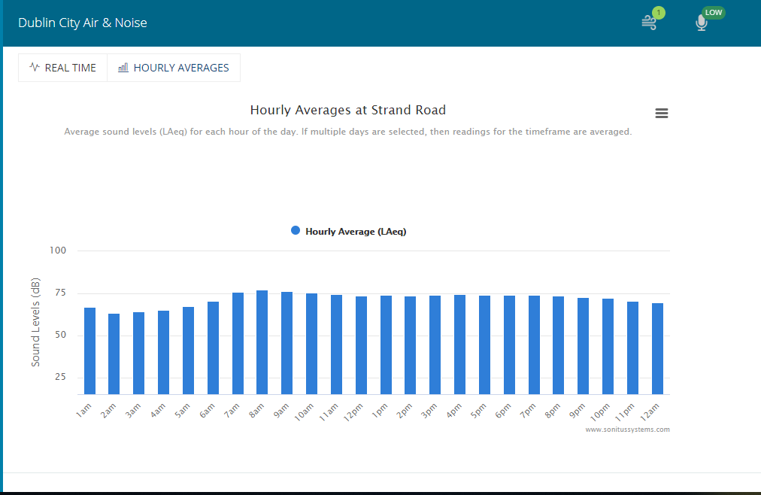
Strand Road has one of the highest noise readings in the City.

Slide 8
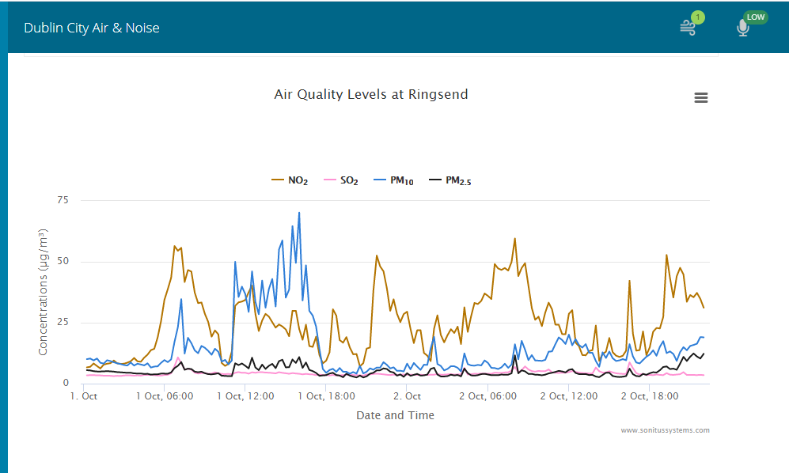
Information available at dublincityairandnoise.ie

Slide 9
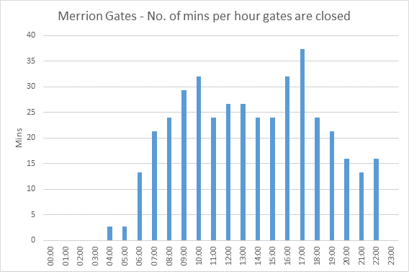
Taken from SCATS Traffic Control System

Slide 10
NTA Eastern Regional Model Findings
Recent traffic surveys (Pre-Covid) indicate:
675 vehs travelling Northbound in AM peak hour at the select link location
634 cars
29 LGVs
12 HGVs
The majority of traffic comes from Merrion Road via Merrion Gates (618 vehs) which is reflected in the Select Link Analysis

Slide 11
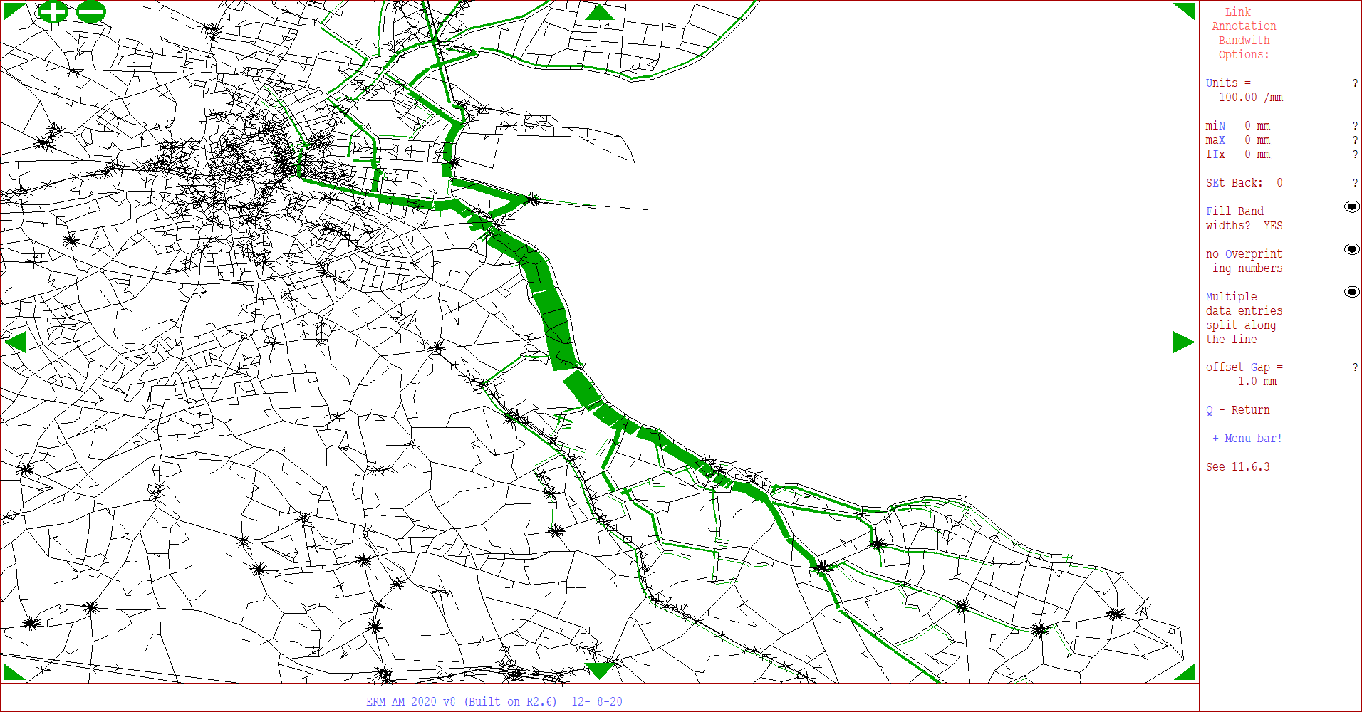
The links in Green show both origin and destination of traffic using Strand Road northbound prior to Covid
AM Peak Hour
Select Link undertaken NB at this location
Merrion Gates

Slide 12
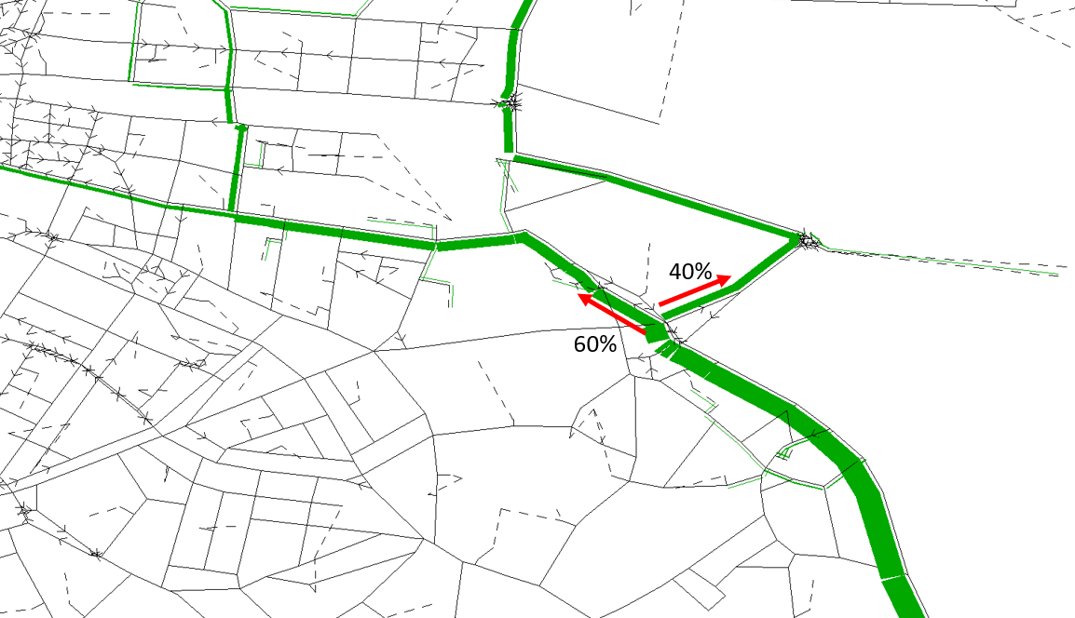
NTA ERM
East Link
Ringsend
Strand Road
The modelled split between traffic heading to East Link and the City Centre

Slide 13
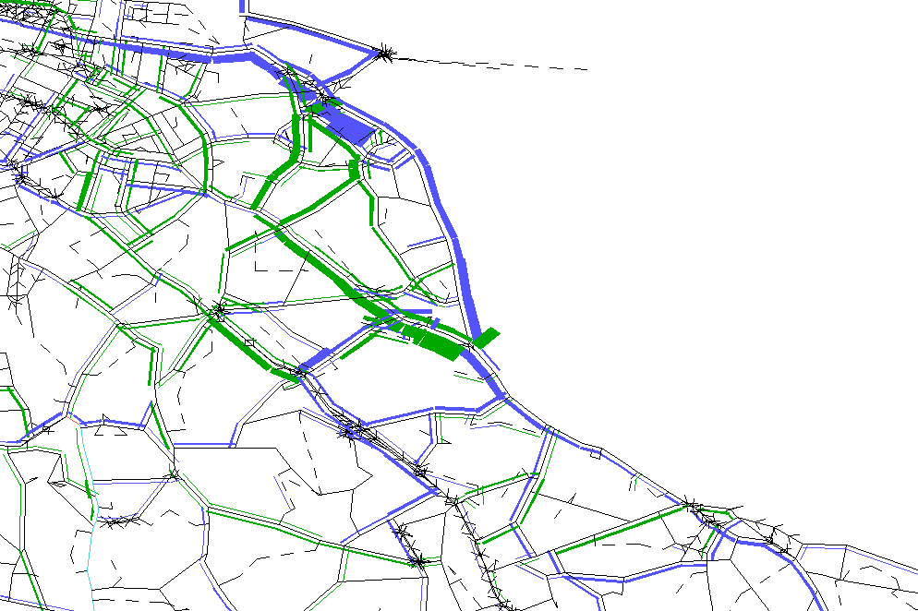
Decrease
Difference of Actual Flow
AM Peak Hour (Current Scenario v Proposed scenario)
NTA ERM
Increase
 |  | 2020 AM flows (pcu/h)
 |  | Reference | Do Something | %Diff
Nutley Lane | Northbound | 766 | 699 | -9%
 | Southbound | 562 | 641 | 14%
Park Avenue | Northbound | 162 | 198 | 22%
 | Southbound | 409 | 406 | -1%
Merrion Rd (North of Merrion gate) | Northbound | 371 | 795 | 114%
 | Southbound | 384 | 466 | 21%
Sandymount Rd | Northbound | 488 | 597 | 22%
 | Southbound | 488 | 467 | -4%
Serpentine Av | Northbound | 359 | 490 | 36%
 | Southbound | 208 | 208 | 0%
Sandymount Av | Northbound | 162 | 264 | 63%
 | Southbound | 174 | 183 | 5%
Merrion Gates
Pre Covid Volumes

Slide 14
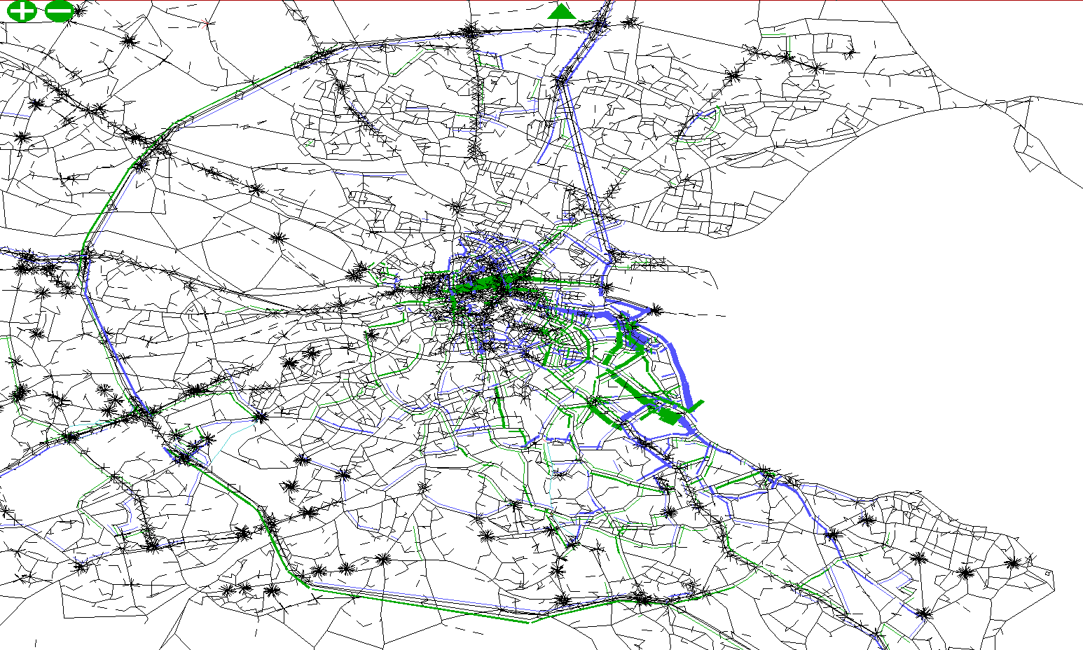
NTA ERM
Difference of Actual Flow
AM Peak Hour (Current Scenario v Proposed scenario)
Decrease
Increase

Slide 15
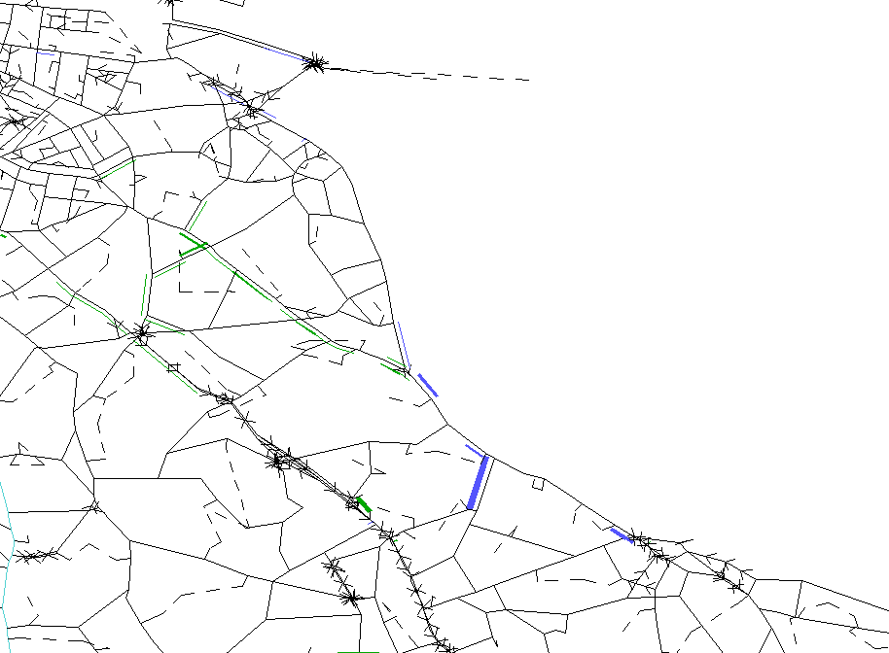
NTA ERM
Difference of Delay
AM Peak Hour (Current Scenario v Proposed scenario)
Merrion Gates
Decrease
Increase

